Slide 1



Slide 2

BUSINESS ANALYTICS Introduction to Business Analytics and Core Business Functions
BUSINESS ANALYSIS Week 2 Lecture: Business Fundamentals

Slide 3

Learning Objectives – WEEK 2
By the end of this lecture you should be able to:
Understand how real companies operate internally
Identify business functions inside an organization
Explain different business models (SaaS, B2B, B2C)
Speak basic business language like a Business Analyst

Slide 4
HOW ORGANIZATIONS OPERATE (CORE CONCEPT)
Think of a company like a living system. Every organization has 3 layers: Strategy = Leadership vision
Operations = Day-to-day execution
Technology = Tools that support execution
Example – Pakistan (Real Case)
Daraz Pakistan
Strategy → Grow online retail
Operations → Vendor onboarding, logistics
Technology → Mobile app, payment gateway
Amazon
Strategy → Customer obsession
Operations → Fulfillment centers
Technology → AI recommendations

Slide 5
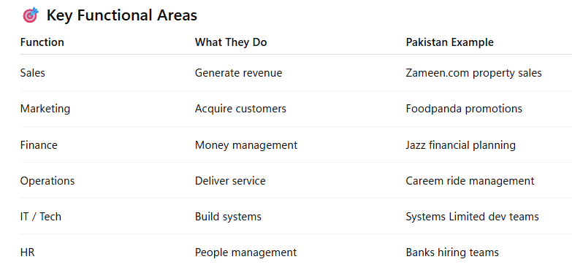
FUNCTIONAL AREAS OF A BUSINESS

Slide 6
BUSINESS MODELS (VERY IMPORTANT FOR BA STUDENTS)
🟣 SaaS – Software as a Service
Subscription-based software.
Examples:
Salesforce
HubSpot
Slack
Pakistani example: Bykea backend tools (similar model internally)
Revenue: 👉 Monthly subscription
🟢 B2C – Business to Customer
Company sells directly to users.
Examples:
Daraz
Netflix
Careem
Revenue Source: 👉 Individual customers
🔵 B2B – Business to Business
Company sells to other companies.
Examples:
Systems Limited consulting
Tkxel software services
SAP enterprise solutions
Revenue Source: 👉 Contracts & projects

Slide 7
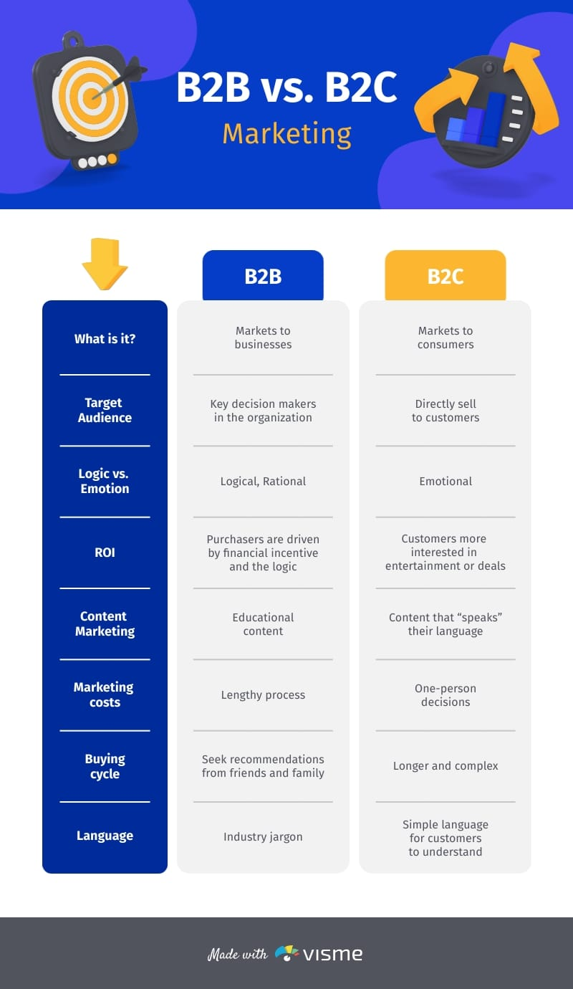
BUSINESS MODELS

Slide 8
BUSINESS TERMINOLOGY EVERY BA MUST KNOW 📊 Key Terms
Revenue
Money coming into business.
Example: Foodpanda delivery fees.
Profit
Revenue – Cost.
👉 “If Daraz sells a phone for 50,000 but delivery costs 48,000 — is that success?”
(Expected: No — profit matters)
Cost
Money spent.
Example: Careem driver incentives.
Stakeholder
Anyone affected by project.
Examples:
Customer
CEO
Developer
Government regulator
KPI (Preview of Week 10)
Measure of success.
Examples:
App downloads
Conversion rate
Delivery time

Slide 9
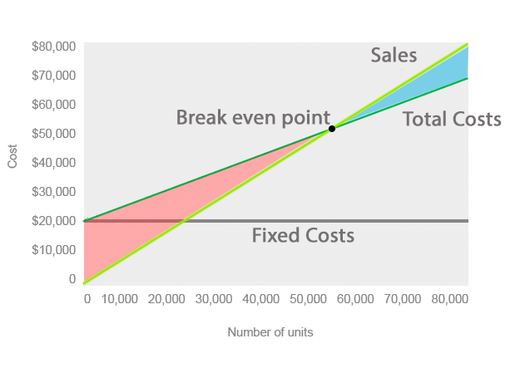
BUSINESS TERMINOLOGY EVERY BA MUST KNOW

Slide 10
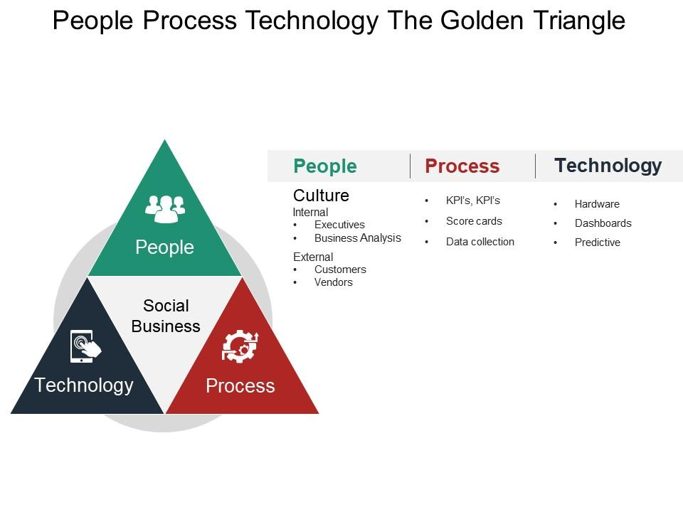
BA TRIANGLE DIAGRAM
A Business Analyst sits in the center balancing all three.

Slide 11
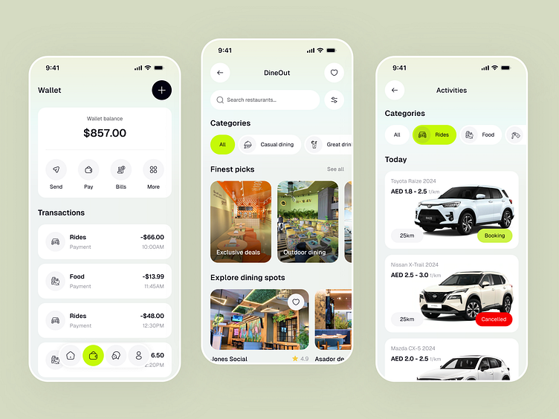
REAL INDUSTRY SCENARIO (HIGH-IMPACT EXAMPLE)
🟠 Pakistan Case – Jazz Telecom
Business Problem: Customers leaving network.
BA Role:
Analyze churn data
Understand customer complaints
Recommend loyalty program
Outcome: Business solution, not just technical solution.
🔴 International Case – Uber
Problem: Driver cancellations.
BA Action:
Analyze behavior patterns
Suggest surge pricing changes
Lesson: BA connects data + business decisions.

Slide 12
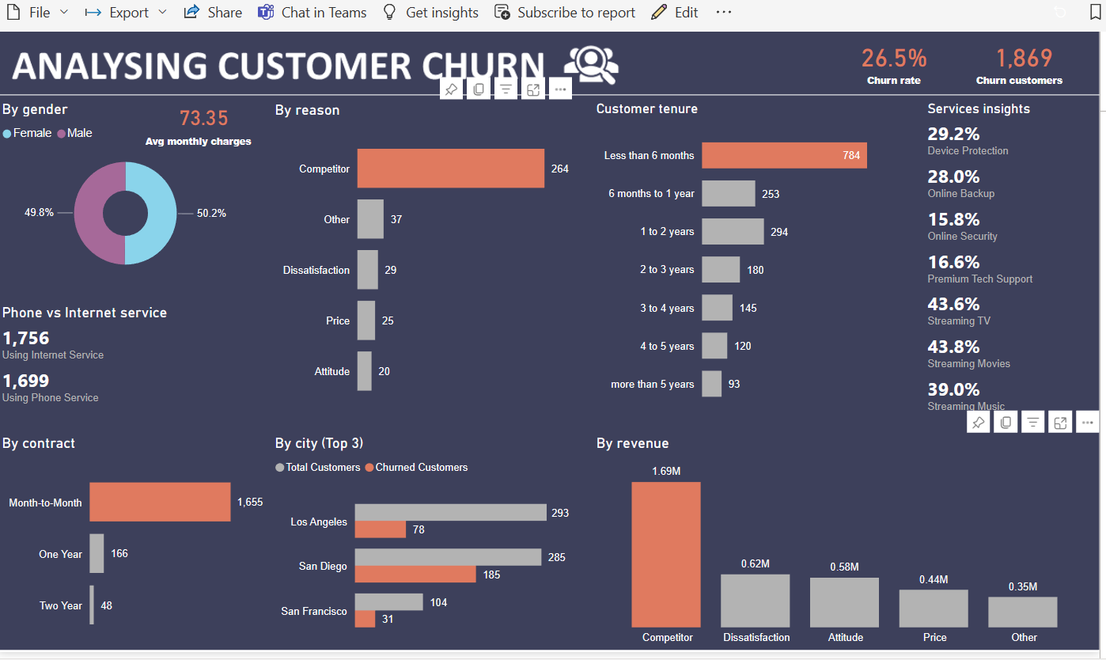
REAL INDUSTRY SCENARIO - DASHBOARDING

Slide 13
Classroom Discussion (5 Minutes)
Pick ONE company:
Daraz
Careem
Netflix
Amazon
Foodpanda
And identify:
✔ Business model ✔ Main functional departments ✔ Revenue source (You can make this a 10-minute breakout discussion.)

Slide 14
“Sometimes design teams focus on UI, but business value is missing.”
“Client escalations usually happen when business expectations are not aligned with technology delivery.”
“A BA’s real job is preventing misunderstandings before they become problems.”

